Slide 1
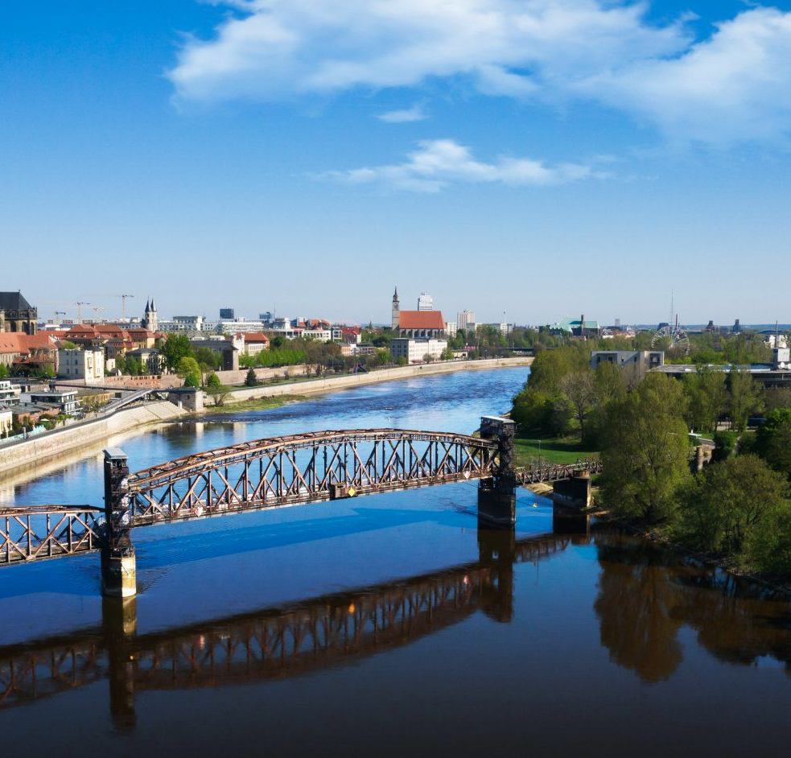
Simulation Project -
Team Tetrahedron
Simulation Project - Team D
Milestone #2 - Plan
Milestone #2 - Plan
Image source: https://cdn.ottopix.de/wp-content/uploads/2019/04/Magdeburg-Panorama-%C3%BCber-der-Hubbr%C3%BCcke.jpg

Slide 2
Agenda
01
02
03
04
Simulation Project - Team D
Milestone #2 - Plan
The tools
The work
Tools used for project management
Schedule, work packet distribution and costs
Monitoring
So far
Estimated and actual costs and progress
Tasks completed and costs incurred so far

Slide 3
01
The tools
Simulation Project - Team D
Milestone #2 - Plan
Tools used for project management

Slide 4
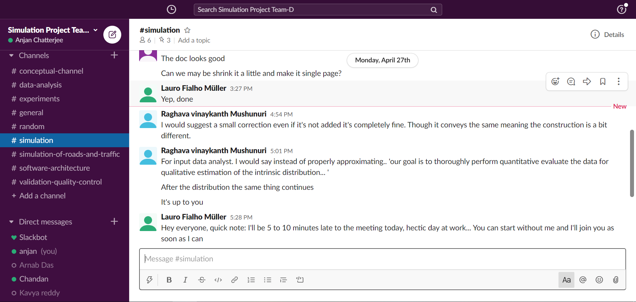
Communication
Simulation Project - Team D
Milestone #2 - Plan
Slack
Discussion according to milestone

Slide 5
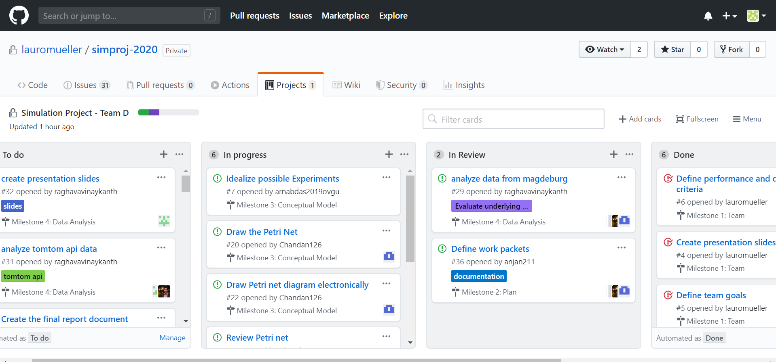
Work management
Simulation Project - Team D
Milestone #2 - Plan
Github
Work packets as issues in Kanban board

Slide 6
Why Kanban?
01
04
02
05
03
Simulation Project - Team D
Milestone #2 - Plan
Open source.
Progress monitoring.
Track milestone schedule.
Create customised workflow.
Assign work packets to members.

Slide 7
02
The work
Simulation Project - Team D
Milestone #2 - Plan
Schedule, work packet distribution and costs

Slide 8
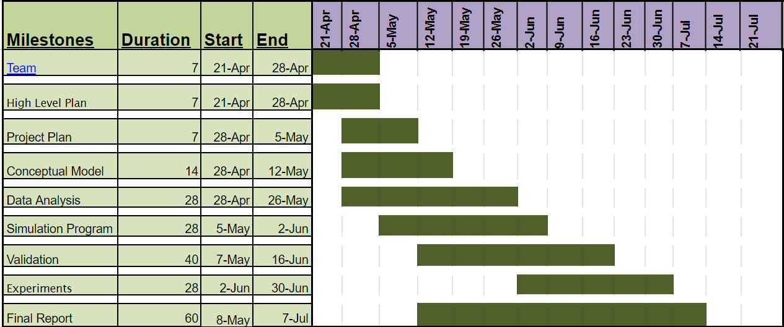
Schedule
Simulation Project - Team D
Milestone #2 - Plan
Note
Milestones running parallel

Slide 9
Work Packet
Milestone 3
Simulation Project - Team D
Milestone #2 - Plan
Conceptual model

Slide 10
Milestone 3
Simulation Project - Team D
Milestone #2 - Plan
Draw the petri net
Conceptual Model
Define the experiments to be performed
Prepare presentation

Slide 11
Milestone 3
Simulation Project - Team D
Milestone #2 - Plan
Define assumptions
Draw the petri net
Define the quantities to be measured
Define the quantities to be used as simulation results
Conceptual Model
Define the experiments to be performed
Prepare presentation

Slide 12

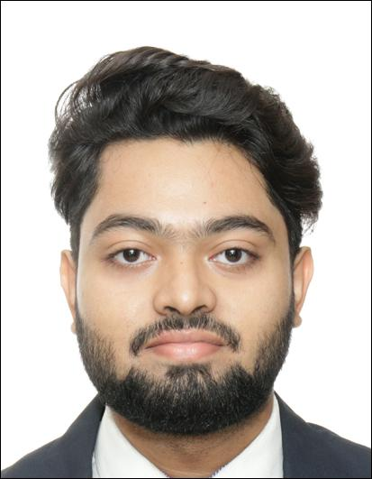

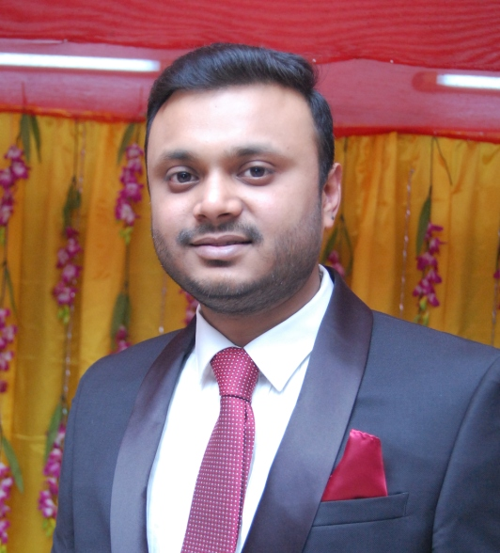
Milestone 3
Simulation Project - Team D
Milestone #2 - Plan
Define assumptions
Draw the petri net
Define the quantities to be measured
Define the quantities to be used as simulation results
Conceptual Model
Define the experiments to be performed
Prepare presentation

Slide 13
Work Packet
Milestone 4
Simulation Project - Team D
Milestone #2 - Plan
Data analysis

Slide 14
Milestone 4
Simulation Project - Team D
Milestone #2 - Plan
Analyse data from the city of Magdeburg
Data Analysis
Analyse the collected data and api data
Prepare presentation

Slide 15
Milestone 4
Simulation Project - Team D
Milestone #2 - Plan
Data cleansing
Analyse data from the city of Magdeburg
Estimating the inter arrival times and probabilities
Plotting histogram and q-q plot to estimate distribution function
Data Analysis
Analyse the collected data and api data
Prepare presentation

Slide 16
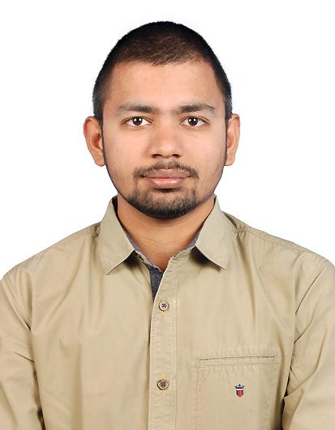
Milestone 4
Simulation Project - Team D
Milestone #2 - Plan
Data cleansing
Analyse data from the city of Magdeburg
Estimating the inter arrival times and probabilities
Plotting histogram and q-q plot to estimate distribution function
Data Analysis
Analyse the collected data and api data
Prepare presentation

Slide 17
Work Packet
Milestone 5
Simulation Project - Team D
Milestone #2 - Plan
Simulation program

Slide 18
Milestone 5
Simulation Project - Team D
Milestone #2 - Plan
Building Simulation model
Run the model and analyse its behaviour
Simulation Program
Verify the model with conceptual design
Prepare Presentation

Slide 19
Milestone 5
Simulation Project - Team D
Milestone #2 - Plan
Road Network and Vehicle Generation
Building Simulation model
Simulation Program coding
Run the model and analyse its behaviour
Define the functions, transitions, events, variables
Simulation Program
Verify the model with conceptual design
Prepare Presentation

Slide 20
Milestone 5
Simulation Project - Team D
Milestone #2 - Plan
Road Network and Vehicle Generation
Building Simulation model
Simulation Program coding
Run the model and analyse its behaviour
Define the functions, transitions, events, variables
Simulation Program
Verify the model with conceptual design
Prepare Presentation

Slide 21
Work Packet
Milestone 6
Simulation Project - Team D
Milestone #2 - Plan
Validation and quality control

Slide 22
Milestone 6
Simulation Project - Team D
Milestone #2 - Plan
Output analysis
Validation and quality control
Compare simulation output with real data
Prepare presentation

Slide 23
Milestone 6
Simulation Project - Team D
Milestone #2 - Plan
Calculate statistics
Output analysis
Confidence intervals
Clarify limitations of program
Validation and quality control
Compare simulation output with real data
Update model where it is not performing
Prepare presentation

Slide 24
Milestone 6
Simulation Project - Team D
Milestone #2 - Plan
Calculate statistics
Output analysis
Confidence intervals
Clarify limitations of program
Validation and quality control
Compare simulation output with real data
Update model where it is not performing
Prepare presentation

Slide 25
Work Packet
Milestone 7
Simulation Project - Team D
Milestone #2 - Plan
Experiments

Slide 26
Milestone 7
Simulation Project - Team D
Milestone #2 - Plan
Create Experiment specific models
Perform Experiments
Experiments
Identify recommendations for customer
Prepare presentation

Slide 27
Milestone 7
Simulation Project - Team D
Milestone #2 - Plan
Justification of experiments performed
Create Experiment specific models
Draw Conclusion
Perform Experiments
Experiments
Analyze experiment output
Identify recommendations for customer
Prepare presentation
Prepare statement of accuracy

Slide 28
Milestone 7
Simulation Project - Team D
Milestone #2 - Plan
Justification of experiments performed
Create Experiment specific models
Draw Conclusion
Perform Experiments
Experiments
Analyze experiment output
Identify recommendations for customer
Prepare presentation
Prepare statement of accuracy

Slide 29
Work Packet
Milestone 8
Simulation Project - Team D
Milestone #2 - Plan
Final report

Slide 30
Milestone 8
Simulation Project - Team D
Milestone #2 - Plan
Create and format final report
Write the overview section
Milestone-specific sections
Final Report
Write the cost overview
Review the final report

Slide 31
Milestone 8
Simulation Project - Team D
Milestone #2 - Plan
Create and format final report
Write the conceptual model section
Write the overview section
Write the data analysis section
Write the simulation program and validation sections
Milestone-specific sections
Final Report
Write the cost overview
Write the recommendations section
Review the final report

Slide 32
Milestone 8
Simulation Project - Team D
Milestone #2 - Plan
Create and format final report
Write the conceptual model section
Write the overview section
Write the data analysis section
Write the simulation program and validation sections
Milestone-specific sections
Final Report
Write the cost overview
Write the recommendations section
Review the final report

Slide 33
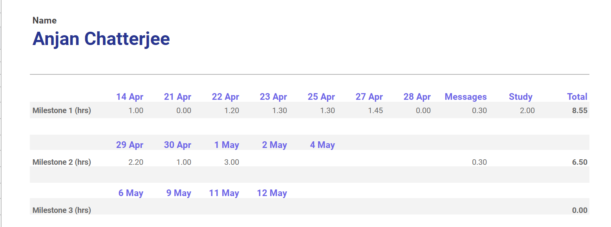
Individual costs
Simulation Project - Team D
Milestone #2 - Plan
Google Sheets
Tracking hours per day

Slide 34
03
Monitoring
Simulation Project - Team D
Milestone #2 - Plan
Estimated and actual costs and progress

Slide 35
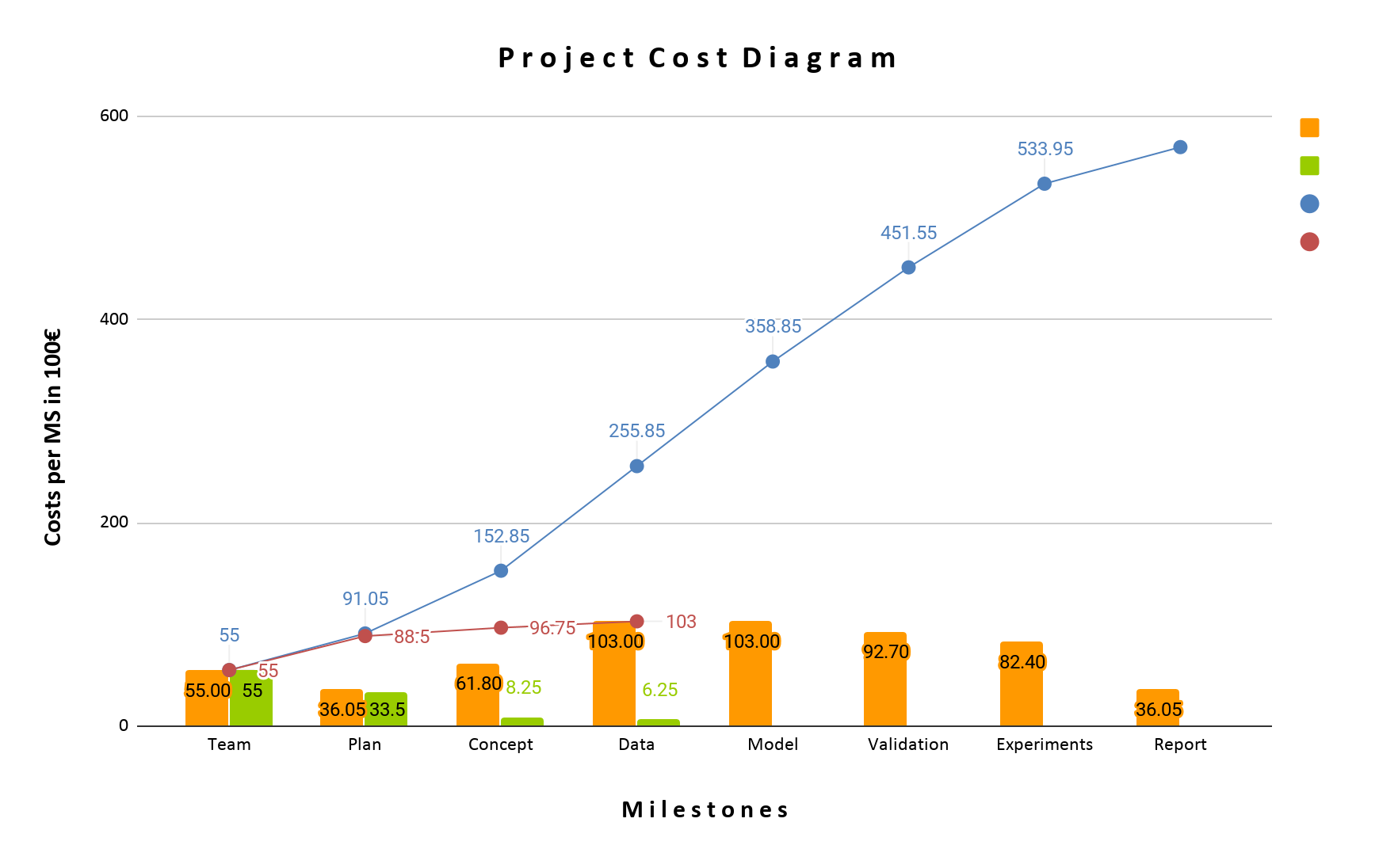
Cost comparison
Simulation Project - Team D
Milestone #2 - Plan
Estimated cost
Actual cost
Cumulative estimate
Cumulative actual

Slide 36
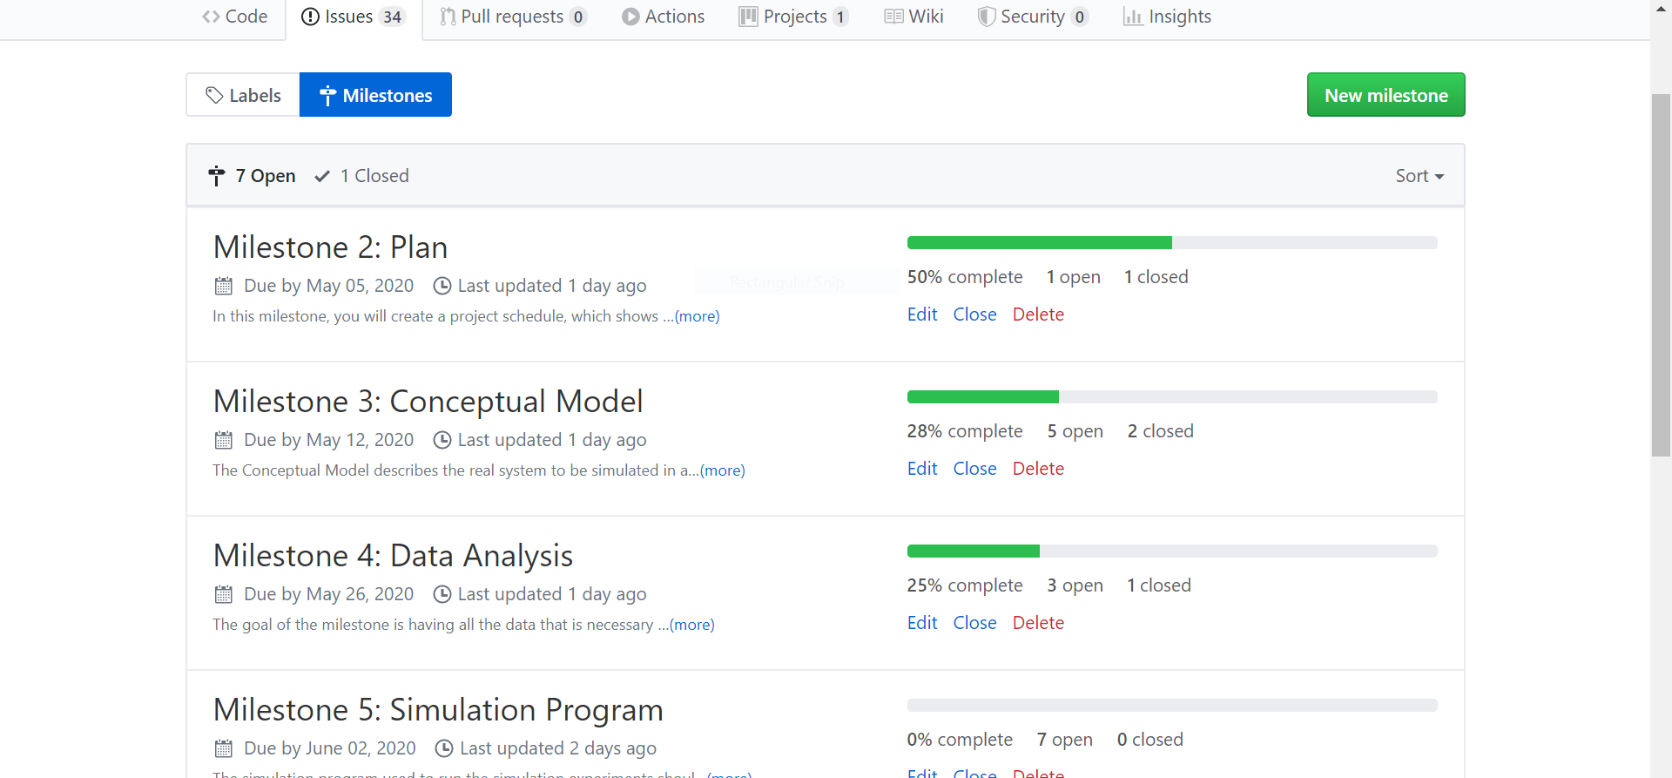
Progress monitoring
Simulation Project - Team D
Milestone #2 - Plan

Slide 37
04
So far
Simulation Project - Team D
Milestone #2 - Plan
Tasks completed and costs incurred so far

Slide 38
Tasks completed so far
✓
✓
✓
✓
✓
✓
✓
Simulation Project - Team D
Milestone #2 - Plan
Define work packets.
Assign work to members
Worked on conceptual model.
Estimate cost per work packet.
Start experimenting with Road Traffic Library.
Update work as issues in GitHub.
Analyze the data from the city of Magdeburg

Slide 39
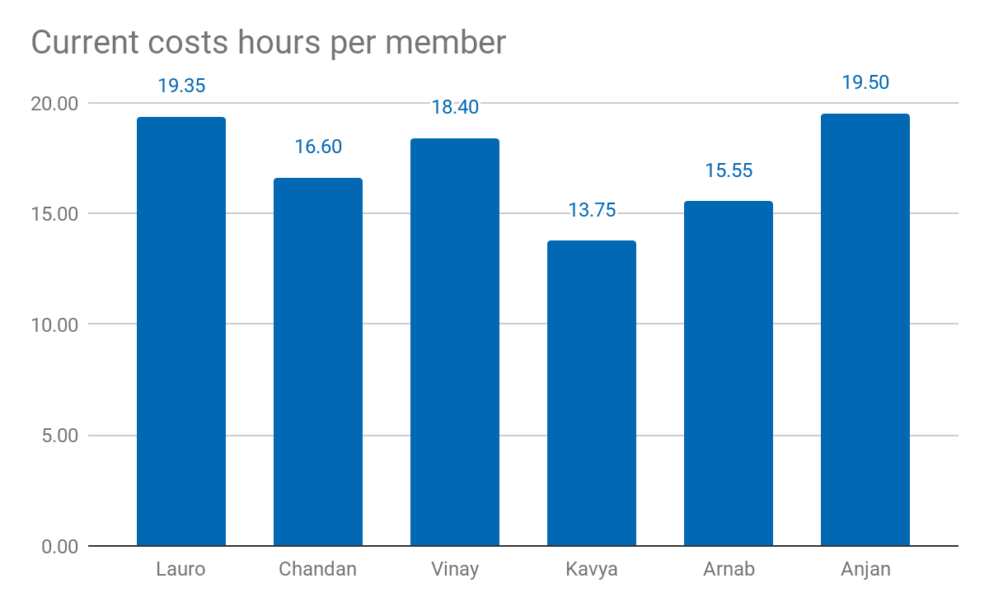
Current costs as % of total cost: 17.19%
Current costs: 10.315,00 €
Simulation Project - Team D
Milestone #2 - Plan

Slide 40
Lessons learned
01
02
03
04
05
Simulation Project - Team D
Milestone #1 - Team
Include this slide
Have a backup person responsible per milestone
Discuss agenda prior to meeting
Timebox the meeting
Update worksheet evenly throughout the week

Slide 41
Lessons learned
01
02
03
04
05
Simulation Project - Team D
Milestone #1 - Team
Include this slide
Have a backup person responsible per milestone
Discuss agenda prior to meeting
06
We are proud of!
Our responsive and active team reduce our workload and volunteer challenges evenly.
Timebox the meeting
Update worksheet evenly throughout the week

Slide 42
05
Thank you!
Simulation Project - Team D
Milestone #2 - Plan
Questions?

